Slide 1

MBEYA UNIVERSITY OF SCIENCE AND TECHNOLOGY
COLLEGE OF INFORMATION AND COMMUNICATION TECHNOLOGY.
DEPARTMENT: ELECTRONICS AND TELECOMUNICATIONS ENGINEERING
PROGRAM NAME: BACHELOR OF ENGINEERING IN TELECOMMUNICATION SYSTEMS
MODULE NAME: MICROWAVE ENGINEERING
MODULE CODE: ET 8314.
INSTRUCTOR’S NAME: MWISOMBA C.
LEVEL: UQF 8 Third Year.
TASK: GROUP ASSIGMENT.
ACADEMIC YEAR: 2024/2025.

Slide 2
GROUP PARTICIPANTS
SN | STUDENT NAME | REG NUMBER | CA NUMBER | SIGN
01 | NURUEL G SHAYO | 22100934340052 | CA/BETS/24/15649
02 | NYABUYOMBO CHAGAGA | 22100934340099 | CA/BETS/24/15626
03 | BONIFACE B SANKWA | 22100934340091 | CA/BETS/24/15646
04 | MSAMILE ASENGA | 22100934340015 | CA/BETS/24/15586
05 | HAPPINESS M BURA | 22100934340062 | CA/BETS/24/15592
06 | EMMILIANA BUKUMBO | 22100934340083 | CA/BETS/24/15591
07 | MATHIAS P MAGESE | 22100934340071 | CA/BETS/24/15620
08 | SIMON KIMWAGA | 22100934340039 | CA/BETS/24/21920

Slide 3
BIPOLAR JUNCTION TRANSISTOR (BJT)
Introduction
Transistors are three-terminal semiconductor devices, and can be categorized as either junction transistors or field effect transistors.
Junction transistors include bipolar junction transistors (BJTs) that use a single semiconductor material (usually silicon), and heterojunction bipolar transistors (HBTs) that use compound semiconductors. Both npn and pnp configurations are possible, but most RF junction transistors are usually of the npn type due to higher electron mobility at higher frequencies

Slide 4

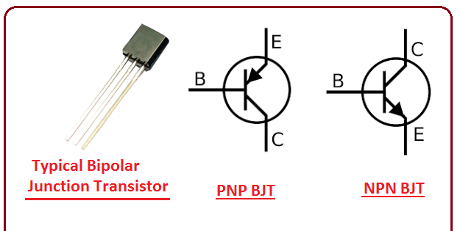
INTRODUCTION
DIAGRAM
Fig 2:Simplified hybrid-π equivalent circuit for a microwave bipolar junction transistor in the common emitter configuration.
Fig 1: Typical junction transistor, PNP bipolar
Transistor, NPN bipolar transistor.
In microwave engineering, a BJT operates in the active region where it amplifies weak microwave signals, making it an essential component for high-frequency applications.

Slide 5
WORKING PRINCIPLE OF BJT.
An active device can do the following:
Control current flow
Amplify signals
Generate oscillations
BJTs are active because they amplify and control signal power. Meaning that BJTs takes a small signal at the base and create a larger version of that signal to the collector.

Slide 6
WORKING PRINCIPLE OF BJT cnt……
In Microwaves, A BJT (BIPOLAR JUNCTION TRANSISTOR) operates based on controlling a large current flow (collector current) with a smaller current (base current)
A BJT regardless of the operating frequency is a current controlled device
A small base current controls a larger current flow between the emitter and collector.
This control is achieved by the forward bias of the emitter-base (BE) junction and the reverse bias of the collector-base (CB) junction

Slide 7
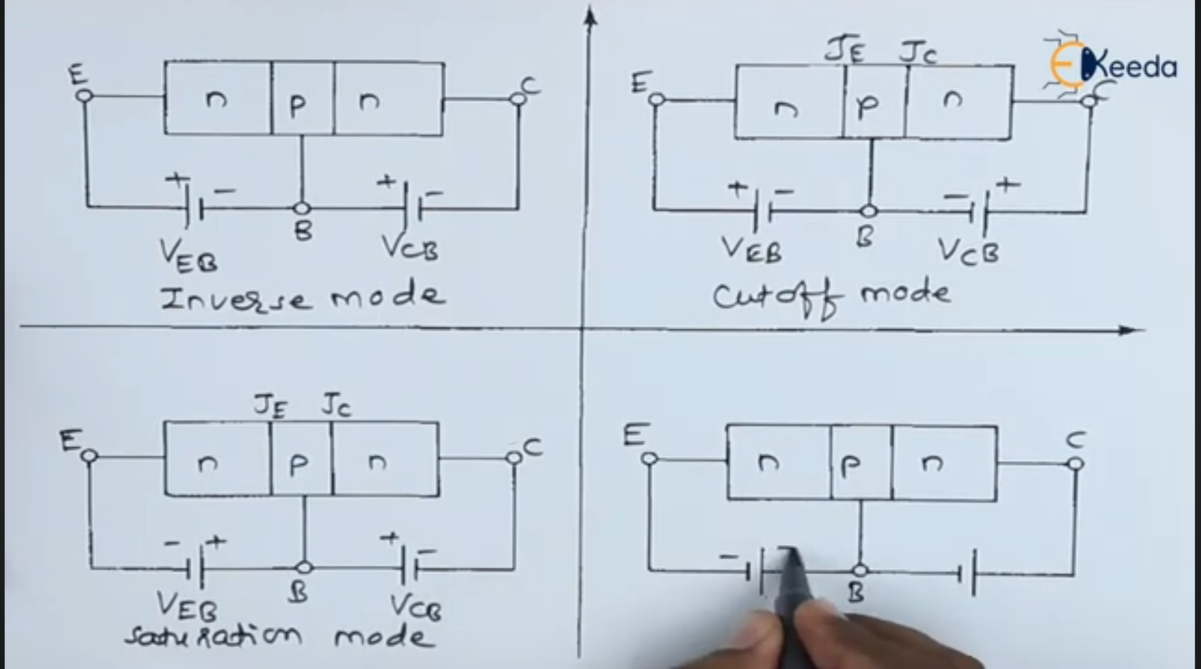
MODES OF MICROWAVE BJT MODES
CUT-OFF MODE (OFF STATE)
Base- emitter junction=REVERSE –BIASED
Base-collector junction= reverse biased
No current flow
ACTIVE MODE (AMPLIFIER MODE)
Base-emitter = forward biased
Base-collector junction =REVERSE BIASED
BJT transistor amplifies current
SATURATION MODE.(FULL ON)
Base-Emitter =FORWARD BIASED
Base-collector junction = forward biased
BJT conducts maximum current.
INVERSE ACTIVE MODE (rarely used)
B-E Junction = revers biased
B-C = forward biased

Slide 8
BJTs IN MICROWAVE ENGINEERING
In microwave engineering, BJT is used in:
Amplifiers (to boost signals)
Oscillators (to generate signals)
Mixers (to combine frequencies)

Slide 9
ADVANTAGES OF BJT IN MICROWAVES
Can amplify very high-frequency signals
- Easy to model using S-parameters
- Reliable and compact design for RF circuits
Fast switching due to small base

Slide 10
APPLICATIONS OF BJTs
SIGNAL AMPLIFICATION
BJTs amplify weak signals by controlling a large collector current with a small base current. This makes them ideal for audio amplifiers, RF amplifiers, and sensor signal boosters.
OSCILLATOR CIRCUITS
BJTs are used in oscillator designs (like Colpitts or Hartley oscillators) to produce periodic signals. The transistor provides the necessary gain to sustain oscillations. Common in radio transmitters, RF signal generators, clocks.
HIGH-FREQUENCY APPLICATIONS (MICROWAVE AMPLIFIERS)
At microwave frequencies, BJTs (specially designed microwave BJTs like HBTs) are used for low-noise amplification in radar, satellite, and wireless systems.

Slide 11
APPLICATIONS OF BJTs cnt….
POWER AMPLIFIERS
BJTs are used in RF and audio power amplifiers to drive loads like antennas or speakers. They handle higher current and power levels.
Found in radio transmitters, audio systems, PA systems.
ANALOG CIRCUITS (E.G., VOLTAGE REGULATORS)
BJTs are part of feedback-based voltage regulators (like linear regulators). They help maintain a steady output voltage.
Often used in series with load to drop excess voltage.
SWITCHING APPLICATIONS (DIGITAL LOGIC & CONTROL)
BJTs can act as electronic switches in logic gates and microcontroller-controlled circuits. In this case, they operate in cutoff (OFF) and saturation (ON) regions.
Used in logic ICs, motor control, LED drivers, etc.

